Slide 1
SALES DATA REPORT

Slide 2

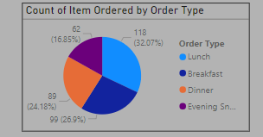
Count of Item Ordered by Order Type
Order Type Distribution: The pie chart effectively visualizes the distribution of item orders across different order types.
Dominant Order Type: "Lunch" is the most popular order type, accounting for 32.07% of all orders.
Other Order Types: "Dinner" and "Breakfast" have relatively similar shares, each around 24-25%. "Evening Snack" represents a smaller portion of orders at 16.85%.

Slide 3
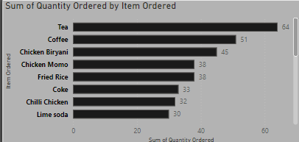
Sum of Quantity Ordered by Item Ordered
Tea is the most popular item: With a total of 64 units ordered, tea significantly outsells all other items.
Coffee and Chicken Biryani follow closely: These items have the next highest quantities ordered, indicating they are also popular choices.
Chicken Momo and Fried Rice: While not as popular as tea, coffee, or chicken biryani, chicken momo and fried rice still have a considerable demand.
Beverages: Coke and lime soda are the least ordered items among the listed options.

Slide 4
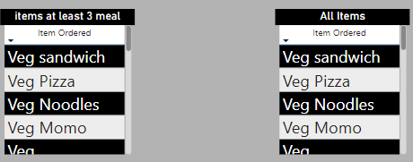
Items at least 3 meals" and "All Items."
No clear distinction between "Items at least 3 meals" and "All Items": Both filters show the exact same items, suggesting either the filters are redundant or there might be an error in the data or filtering logic.
Missing data: The list of items appears incomplete. It's possible that there are other items that meet the "at least 3 meals" criteria but are not included in the list.
Data inconsistency: There might be inconsistencies in the data regarding the number of meals for each item. For example, an item might be counted as "at least 3 meals" in one part of the system but not in another.

Slide 5
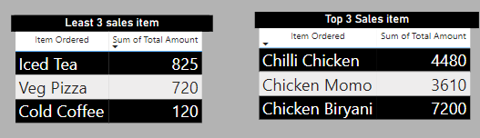
Analysis of the Item Sales Data
Top-Selling Items:
Chilli Chicken is the clear leader with the highest total sales amount.
Chicken Momo and Chicken Biryani also perform well, indicating a strong demand for chicken-based dishes.
Least 3 Sales Item:
Iced Tea, Veg Pizza, and Cold Coffee are the items with the least sales.
This might suggest that these items are less popular or have been recently introduced to the menu.

